Slide 1

System Requirements Review
Nikolai DiLullo, Alexandra Friebolin, Alexia Hnatowicz, Jacob Morrissette, Joseph Sedutto

Slide 2



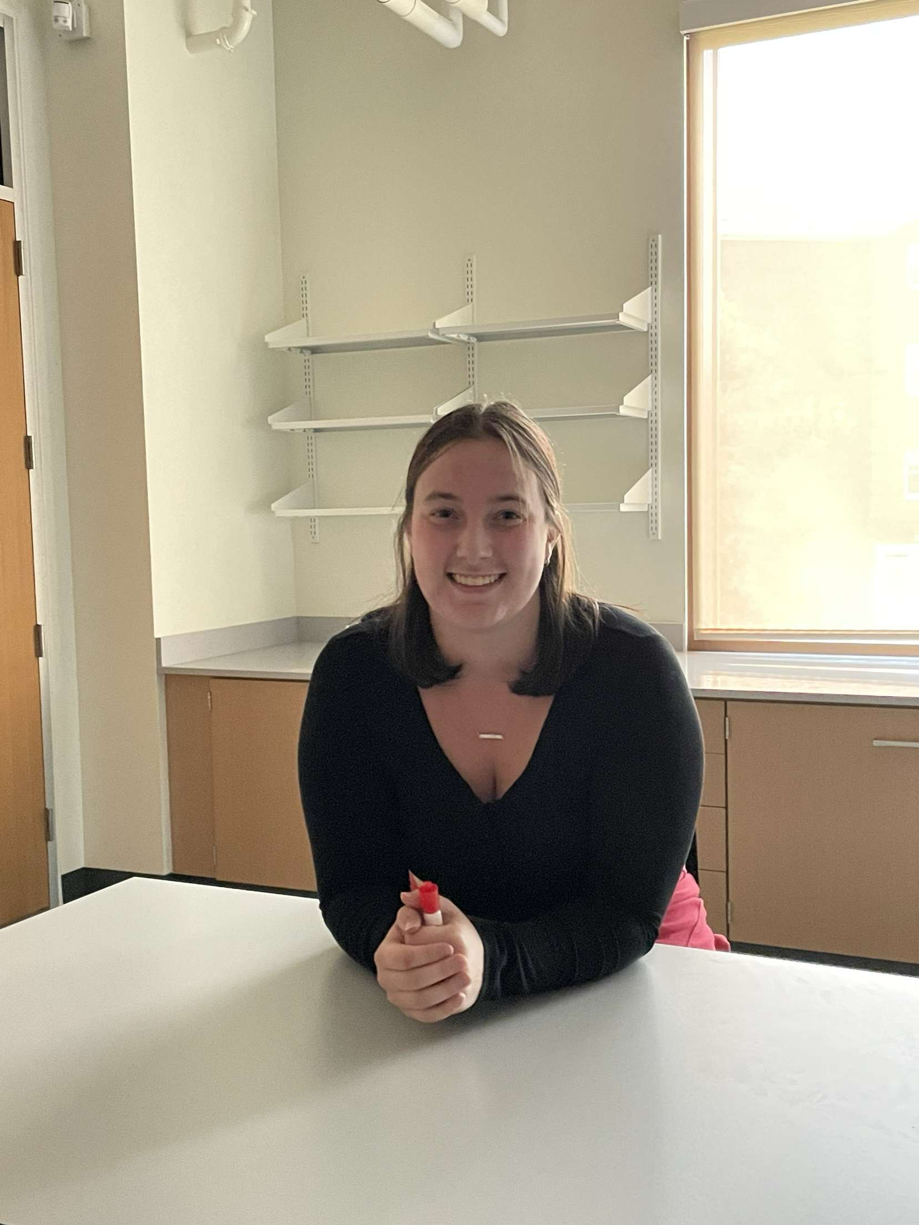

Project Team & Roles
Alexandra Friebolin
Program Lead
(M.E.)
Jacob Morrissette
Chief Test Engineer
(M.E.)
Nik DiLullo
Chief Analyst
(E.E.)
Joe Sedutto
Systems Engineer
(E.E.)
Alexia Hnatowicz
Project Engineer
(M.E.)

Slide 3
Agenda
System Concepts & Description
Customer Requirements
Research and Analysis
Functional Block Diagram
ConOps Summary
Requirements Database
Driving Requirements
Primary Subsystem Requirements
Risk Assessment
Project Schedules
Next Steps
Sources

Slide 4
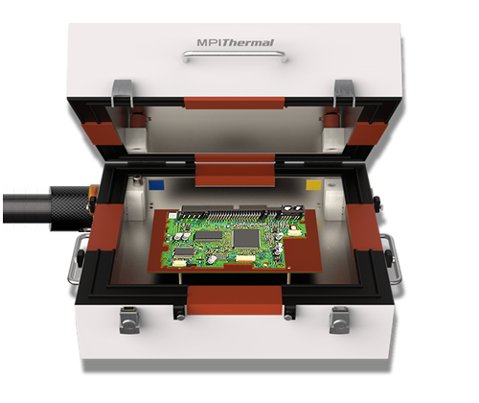
System Concepts & Description
This system will be a thermally controlled Printed Circuit Board ("PCB") testing chamber. It is a table-top system designed to be easy to use and operate.
It will test and evaluate PCBs through changing or static temperature ranges, a common method of PCB evaluation
Notes:
Overall description PCB testing chamber, lives on a tabletop. Has software and Hardware components to control the internal enviornement

Slide 5


Customer Requirements
Minimum Performance 0C – 70C
Optional Performance goal, -40C – 85C
Accommodate a 12"x12" PCB
Ideal height ~ 6"
Insulation sufficient for extended operation at desired temperatures.
Port/Gland to allow for interface inside chamber to testing units
Provide data output (Serial, File, Etc)
Maintain 3C temperature accuracy
Human Machine Interface (HMI)
Readable, Usable, Reasonably Ergonomic
I'm rather fond of team thermocline

Slide 6
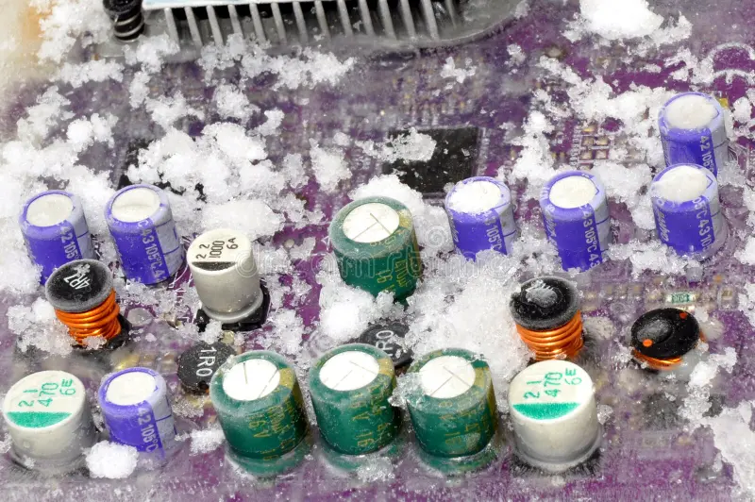
Research & Analysis
Commercial Systems (Single Stage)
Limited ranges, smaller. Precise humidity.
Commercial Systems (Dual Stage)
Much larger
Commercial Subsystems
Heating & Cooling Processes
Sensors & Components
Resistive Heat
Cheap, easy to implement
Reversable Heat Pumping
Eliminates need for resistive heat, but makes temperature range symmetric
Chilled Glycol
Very expensive, extremely easy to integrate
Notes:
Single stage commercial, single refrigerant, limited ranges
Dual stage, much larger (price, size, power and range)
Commercial Subsystems are heating and cooling
And sensors and etc

Slide 7
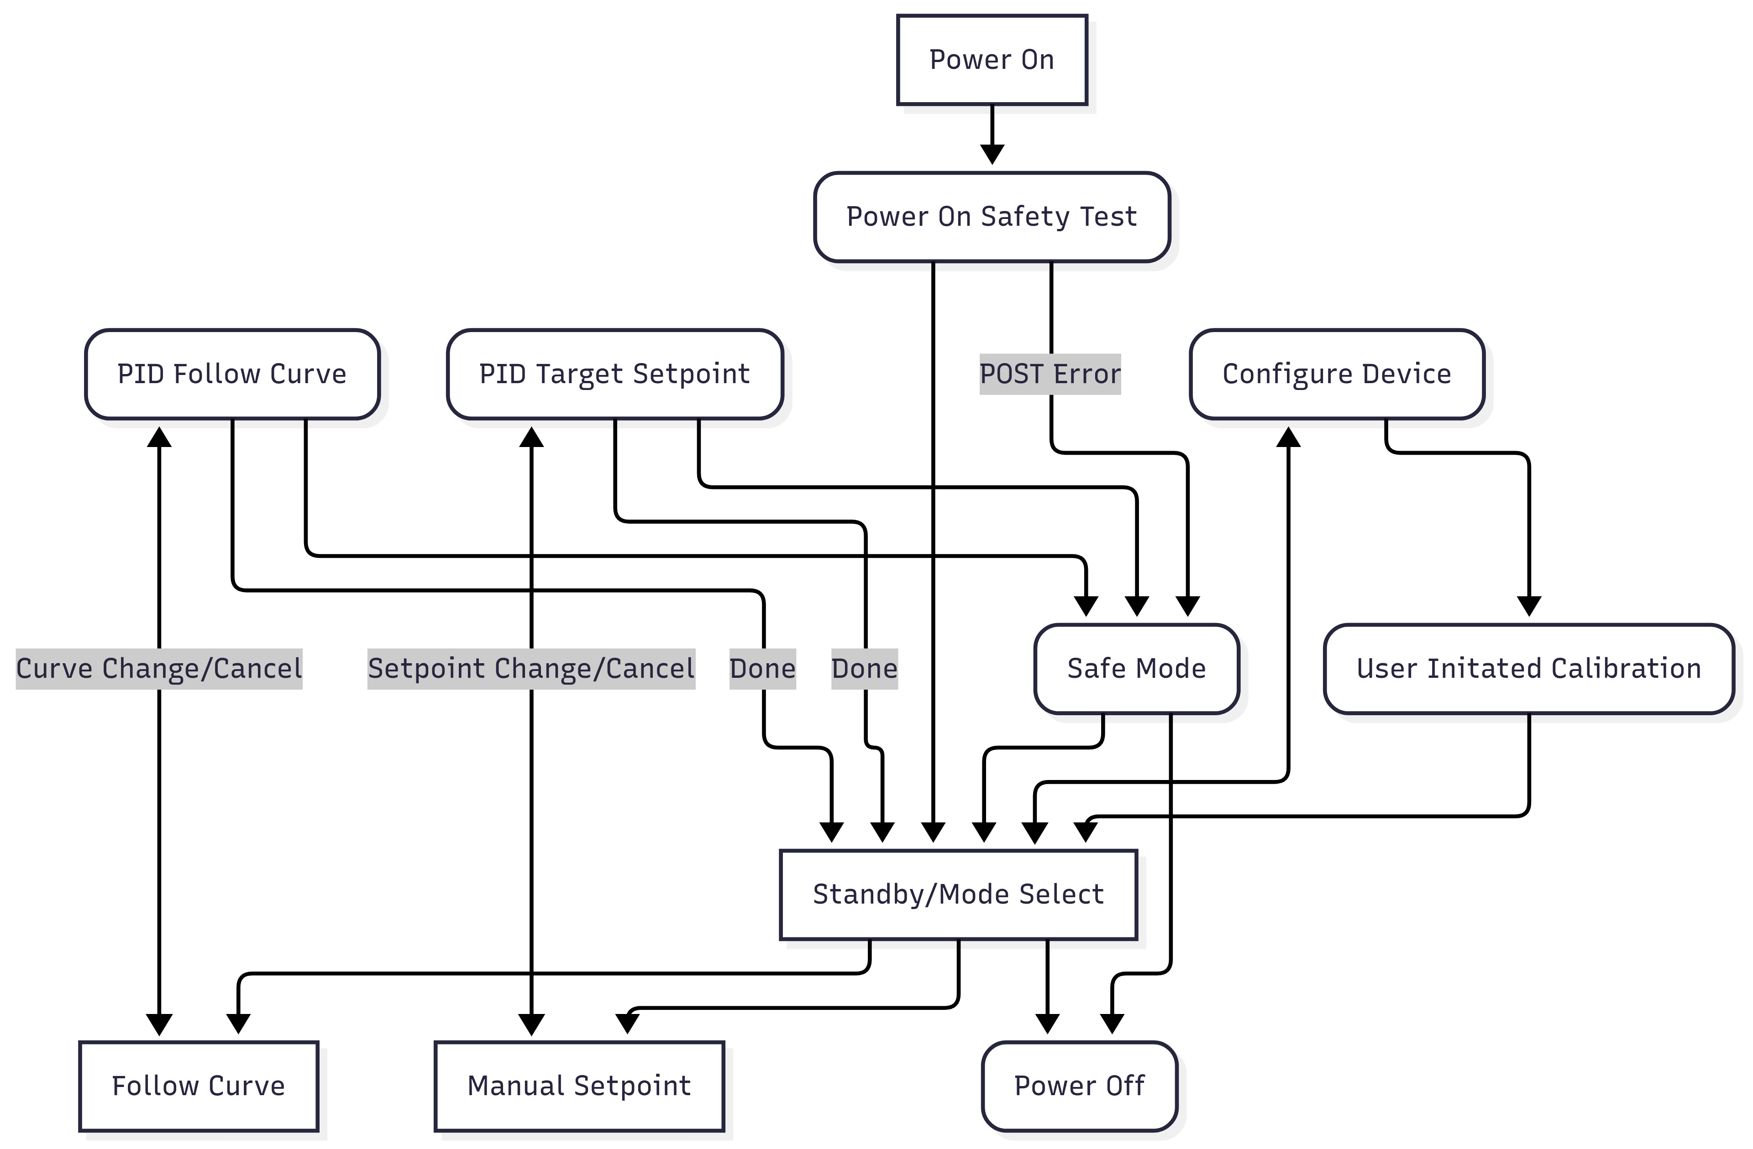
Functional Block Diagram
Notes:
Between the modes, power on, power off. The system performs a quick POST test
A core standby/mode select Then Configration, Calibration, PID target and Curve Target

Slide 8
ConOps Summary
Physical Environment: This system will be operated in a predictable indoor environment with access to ventilation with a sufficient and consistent source of power.
Support Environment: This system will have proper access for maintenance with the necessary tooling and testing, alongside an electrical supply of 120V-AC power.
Operating Modes: The system will have 4 total operating modes- Shutdown, Standby, Start, and Safe.
Use: The system will be used in a laboratory setting to test PCBs under controlled thermal conditions.
Stakeholders: Engineers, Maintenance, SNHU Faculty & Sponsor, Electronic/Thermal-based Manufacturing Companies & Suppliers.
Impact Considerations: Material, electrical safety, physical safety, excessive use, adequate storage or space, and complying with safety codes.
Risks: Asset, Cost, Human Safety, Performance, Schedule
Notes:
Physical Env: Indoor, External Power, Ventalation
Support: Servicable, Interfaceable with standard wall outlet, db9
Operating Modes: Four critical modes, shutdown, standby, start, safe
Use:

Slide 9
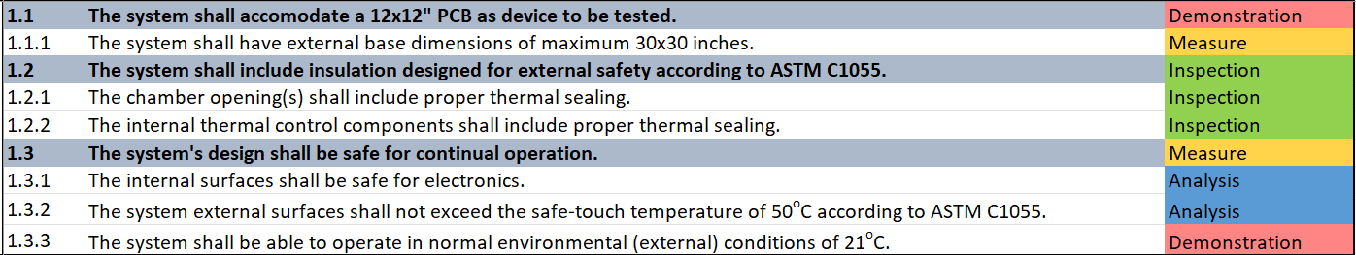
Requirements Database- Design
Notes:
12x12 internal minimum. Customer requested that we also consider edge and corner connectors
Insulation
Safe for autonomous/long run operation

Slide 10
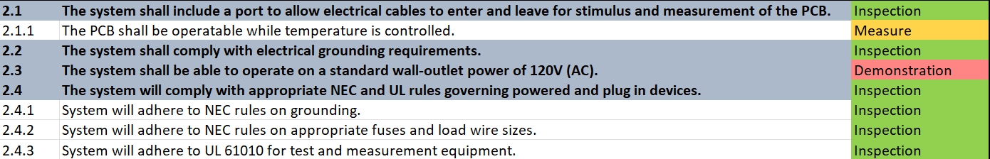
Requirements Database- System

Slide 11
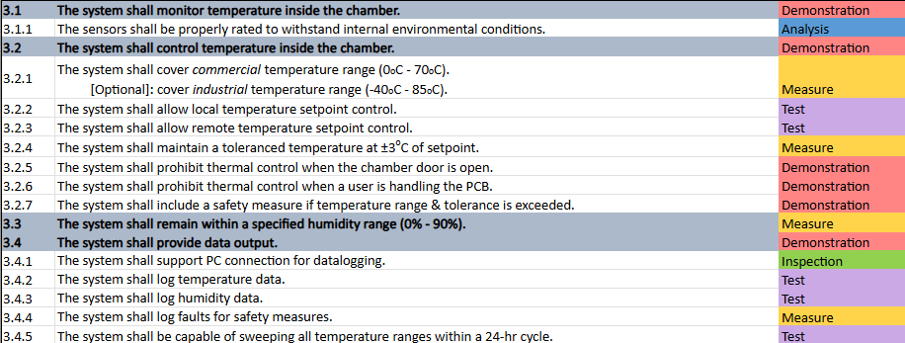
Requirements Database- Functional

Slide 12
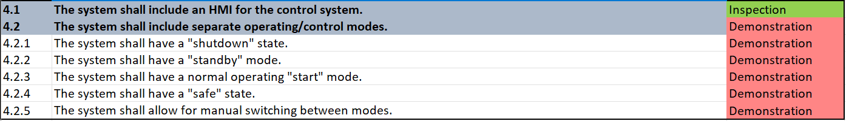
Requirements Database- Interface

Slide 13
Driving Requirements
1.1 - The system shall accommodate a 12x12" PCB as a device to be tested.
2.1.1 - The PCB shall successfully operate while temperature is fluctuating.
3.2.1 - The system shall cover commercial temperature range (0-70°C)
3.2.4 - The system shall maintain a temperature ±3°C of setpoint.
3.4.5 - The system shall be capable of sweeping the temperature range in a 24-hour cycle.

Slide 14
Primary Subsystem Requirements
Electrical
Standards for both components & connections
Properly connecting all subsystems
Mechanical
Materials (surfaces, components, resources) are selected for the application
Components operate effectively
Properly sized design for easy access, use, and operation
Software
Operating modes
User Interface
Data Output
Control System

Slide 15
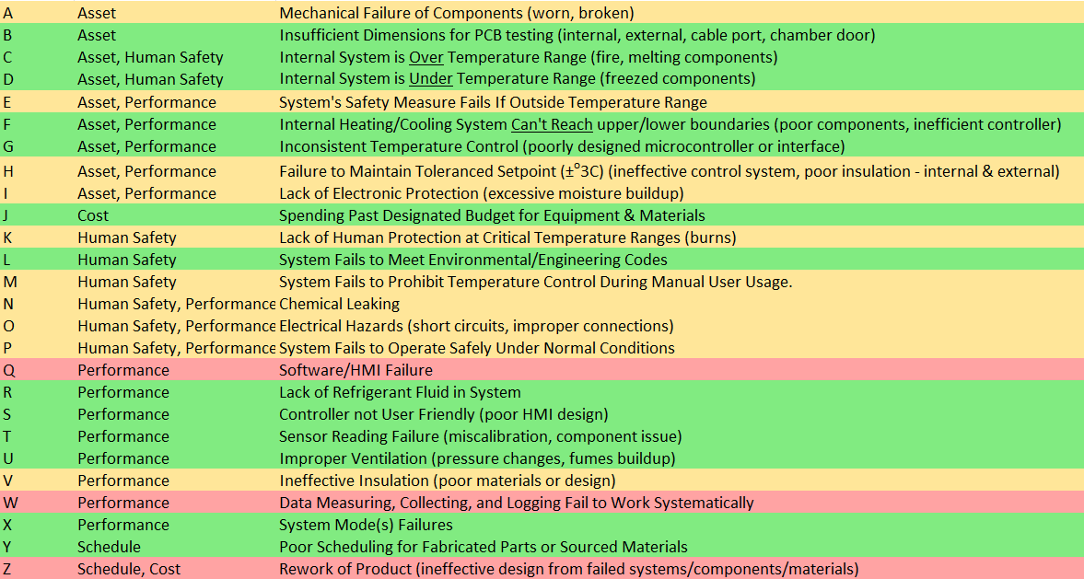
Risk Assessment - List

Slide 16
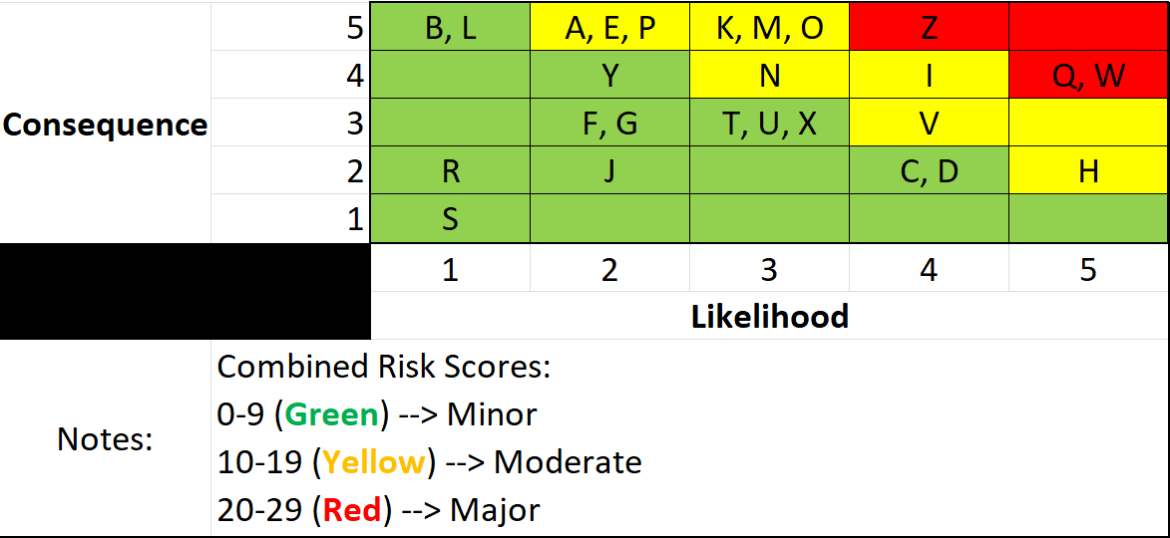
Risk Assessment - Matrix

Slide 17
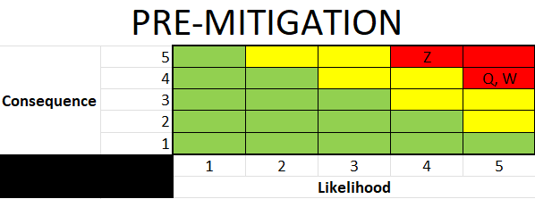
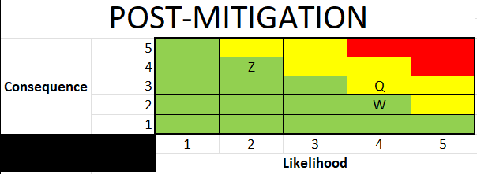
Mitigations
Risk Letter | Risk Score | Description | Effects | Mitigation
Q | 20 | Software/HMI Failure. | Lack of system input and control. | Hardware Watchdogs, implementing secondary/backup control features.
W | 20 | Data measuring, collecting, and logging fail to work systematically. | System lagging, inaccurate measurements. | Repeated calibration and testing, and more sophisticated components.
Z | 20 | Product fails to meet requirements. | Product redesigning, sourcing of new components, falling off schedule. | Early and substantial amounts of research, feasibility testing, and analysis.

Slide 18
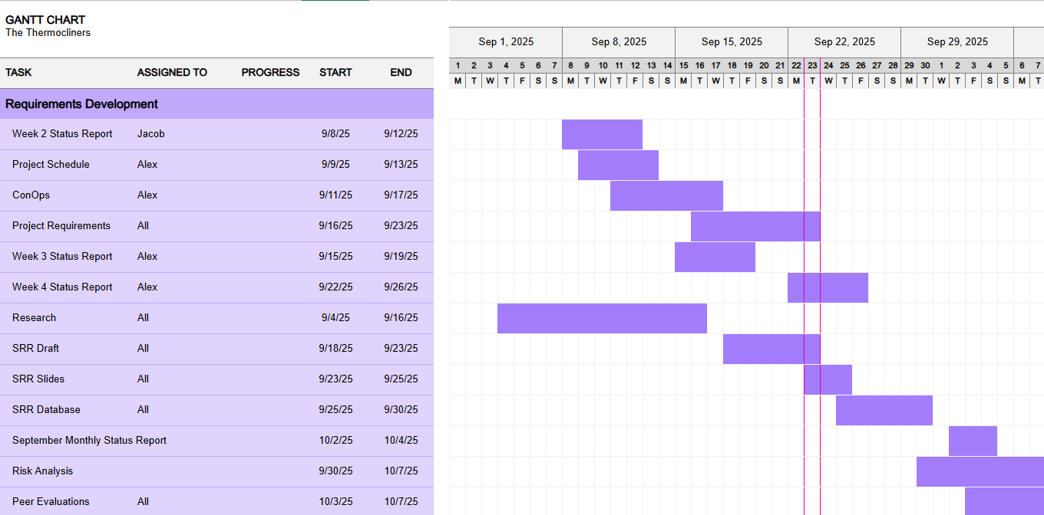
Project Schedules

Slide 19
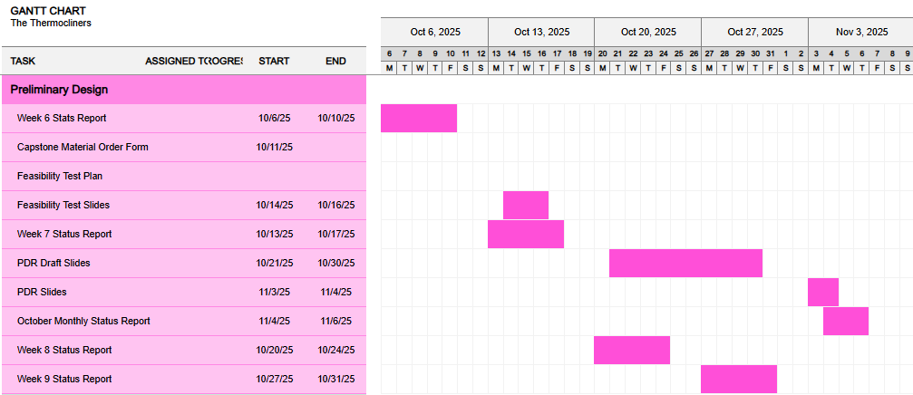
Project Schedule

Slide 20
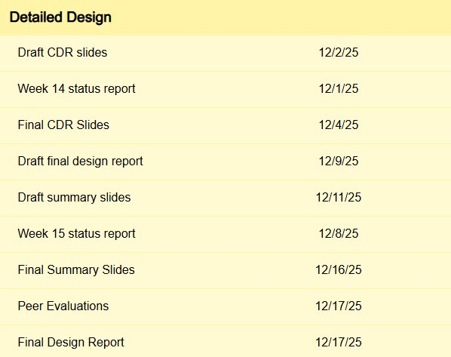
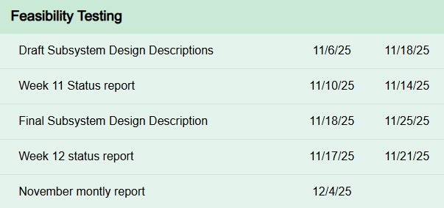
Project Schedule

Slide 21
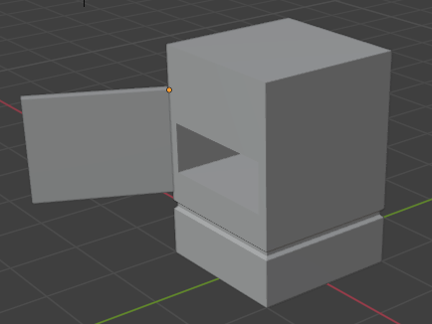

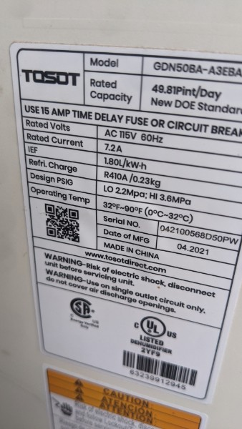
Next Steps...
Trade Studies
Preliminary Design
Risk Analysis
Further Analysis

Slide 22
Sources
Vasileiou, K., Barnett, J., Thorpe, S., & Young, T. (2018). Characterising and justifying sample size sufficiency in interview-based studies: systematic analysis of qualitative health research over a 15-year period. BMC Medical Research Methodology, 18(1). https://doi.org/10.1186/s12874-018-0594-7
Belouafa, S., Habti, F., Benhar, S., Belafkih, B., Tayane, S., Hamdouch, S., Bennamara, A., & Abourriche, A. (2017). Statistical tools and approaches to validate analytical methods: methodology and practical examples★. International Journal of Metrology and Quality Engineering, 8, 9. https://doi.org/10.1051/ijmqe/2016030
Whyte, J., & Davies, A. (2021). Reframing Systems Integration: A process Perspective on projects. Project Management Journal, 52(3), 237–249. https://doi.org/10.1177/8756972821992246

Slide 23
Questions?
2500 North River Road
Manchester, NH 03106
603.xxx.xxx
snhu.edu

